Slide 1


Transforming Data Management with
the Decentralized .madrid Domain
Ensuring transparency, data ownership and efficiency in the Web3 and AI era

Slide 2



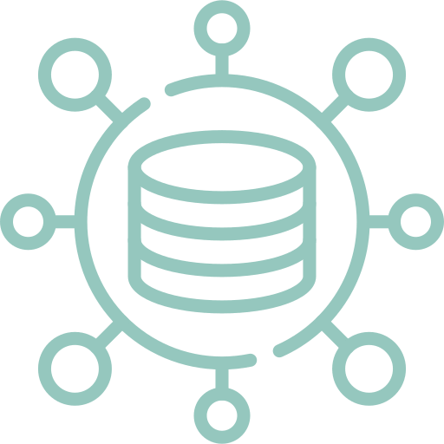
TODAY’S DATA CHALLENGES
Today, companies and public institutions face critical data management challenges that impact transparency, trust, and efficiency in governance, undermining citizen confidence.
Fake Data & Misleading Information
Traceability & Transparency Issues
Data Silos & Lack
of Interoperability
Centralization & Lack of Data Control
Notes:
Necesidad de estándares uniformes para datos.

Slide 3

ECONOMIC
IMPACT
6.200
milions €
lost annually due to fake data and counterfeit
90.000
milions €
lost annually due to fraud in public procurement
Using AI and Blockchain
Reduce incidents with false data by 60% and increase operational efficiency by 30%
80%
Spanish citizens
distrust public institutions' transparency

Slide 4

ON-CHAIN DNS FOR THE NEW INTERNET
The benefits of Blockchain and AI
Traditional DNS focuses only on domains, not on individual documents, making it harder to find and access data
DNS
Server
DNS3
Context DNS3 enables granular data management and discovery within Web3, indexing content with deep semantic understanding to ensure models access accurate, up-to-date information through blockchain technology
Organize, store, structure and verify real-world data in Web3 storage with the innovative and decentralized DNS3
.madrid
Blockchain Registry
Verified Data

Slide 5

INTRODUCING A DECENTRALIZED AND GLOBAL .madrid DOMAIN
We are creating a decentralized .madrid domain within the onchain DNS3. This innovative solution will empower Madrid to offer a transparent, secure, and decentralized digital identity for public services. By removing centralized control, the .madrid domain will ensure true ownership of data, enhance transparency, and provide resilient infrastructure against censorship and data breaches.The creation and curation of these domains will be governed by a future Decentralized Autonomous Organization (DAO), ensuring democratic oversight and community-driven management.
This will not only modernize Madrid’s digital presence but also align it with the principles of Web3, creating a trust-based ecosystem for citizens, businesses, and public institutions.
Notes:
Data Entry and Verification: "Producers and stakeholders submit data, which is verified and stored on a blockchain, ensuring immutability and transparency."
Semantic Search Capabilities: "AI-powered search functionalities allow users to easily find and access relevant information.

Slide 6
UNLOCKING THE FUTURE OF PUBLIC DATA
Access a unified and transparent .madrid database, providing accurate and up-to-date information on public records and government services, like government-issued documents.
Empower citizens and institutions to maintain full control over their data, ensuring privacy, security, and protection against unauthorized access and manipulation.
Ensure all services and platforms are consistently updated under a verified .madrid domain. For example, if a citizen updates their address on one government platform, it’d automatically update across all relevant services.
Transparent and Public database
True ownership of your data
Consistent across the internet
Enhance the traceability of government processes and public services, increasing trust and transparency. Tracking the progress of projects in real-time ensures accountability and reduces the risk of mismanagement.
Utilize standardized data formats to ensure seamless interoperability across all platforms and AI agents. This could allow census data to be easily shared and analyzed across various ministries, improving efficiency and accuracy.
Ensuring that all data under the .madrid domain is instantly propagated. This allows information to be always up-to-date and optimally available for AI training, while keeping it secure and trustworthy thanks to blockchain technology.
Improved traceability
Data Standardization
Real-time updates
Notes:
Problems:
Centralized: A web3 bono existeix un unic DNS, interoperability
AI: Unprepared for AI - trust, verificable
Data: Domain level and not for documents - On web3 cannot find data, hashes
Solutions:
Desceltralized: Global DNS, interoperability, onchain
AI: Read for AI with semantic, relations, trust, etc etc
Data: Store data pn web3 strorage descentralized, adoption for companies

Slide 7


HOW DNS3 AND AI CAN HELP
Today, people increasingly rely on chat-based interactions for information rather than traditional search engines. This shift underscores the growing importance of AI in key sectors like public administration, where accurate and timely data is crucial for both citizens and institutions. AI models, powered by Context DNS3 technology, can access verified, high-quality, and semantically structured data, which is essential for informed decision-making in governance, transparency, and operational efficiency.
DNS3 also addresses the limitations of traditional AI in understanding complex relationships within public administration. By providing structured data and meaningful relationships, DNS3 enhances the training of AI models using Retrieval-Augmented Generation (RAG), optimizing.
Context DNS3 revolutionizes the indexing of Web3 content by providing deep semantic understanding and structure to train AI models with verified data.
Key Applications and Benefits
Verification of Public Services
Data Integrity and Authenticity
Regulatory Compliance
Public Trust and Reputation
Certification and Verification

Slide 8
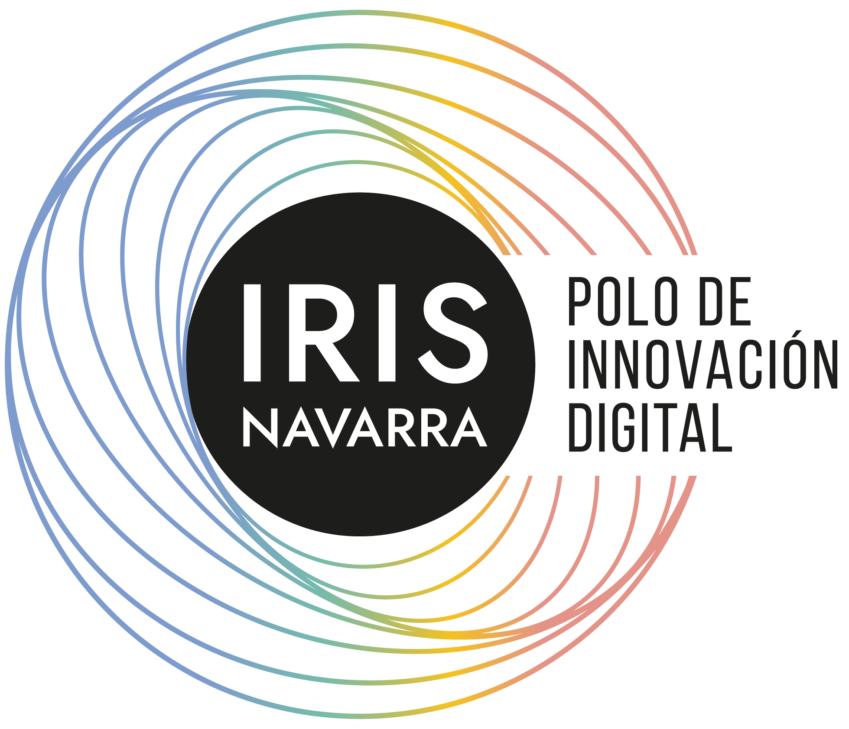

CASE STUDY: TRANSFORMING PUBLIC SERVICES WITH POLO IRIS NAVARRA AND CONTEXT
PoloIris Navarra, an initiative impulsed by the Government of Navarra, is pioneering a new standard in public administration by integrating the .na domain with DNS3. This project aims to enhance trust, transparency, and data ownership across all public services.
· Onchain Mapping of Public Services: Public services in Navarra are mapped on the blockchain using the .na domain, ensuring verifiable and transparent access.
· Decentralized Domains for Verified Companies: Each service provider receives a verified .na domain, ensuring only authenticated entities operate within the public administration.
· Self-Managed Data on Blockchain: Companies maintain full control of their data onchain, guaranteeing integrity, security, and real-time updates.
· Enhanced Public Trust and Transparency: DNS3 strengthens public trust by making government services transparent and easily verifiable by citizens.
Notes:
it enhances transparency by making public services and companies fully visible on the blockchain, reduces fraud, and strengthens accountability. Companies maintain sovereignty over their own data, ensuring it is accurate, secure, and consistently up-to-date. This approach also bolsters public confidence, as citizens can trust the legitimacy of services and providers, knowing they are verified and transparent.

Slide 9
Ensuring transparency, data ownership and efficiency in the Web3 and AI era
Notes:
"The New Standard for Wine in the Web3 Era"
"Revolutionizing Wine Data Management in Web3"
"The Future of Wine Data on the New Internet"
"Empowering the Wine Industry with Decentralized Data Solutions"
"Transforming Wine Industry Data for the Digital Age"

